Slide 1
Intro to UNIX command line Day 1
Asli Yildirim, QCBio Fellow
asliyildirim@g.ucla.edu
(Marina Linardic will be helping in the chat session)

Slide 2
Intro to UNIX command-line
Day 1
General introduction about UNIX command-line
Navigating through UNIX file system
Create/move/copy/remove files in UNIX file system
Day 2
Useful UNIX commands for visualizing files
Text processing
Day 3
Awk
Shell Scripting
Gnuplot
Running jobs on Hoffman2
Thanks Peter Scott & Serghei Mangul for base slides.

Slide 3
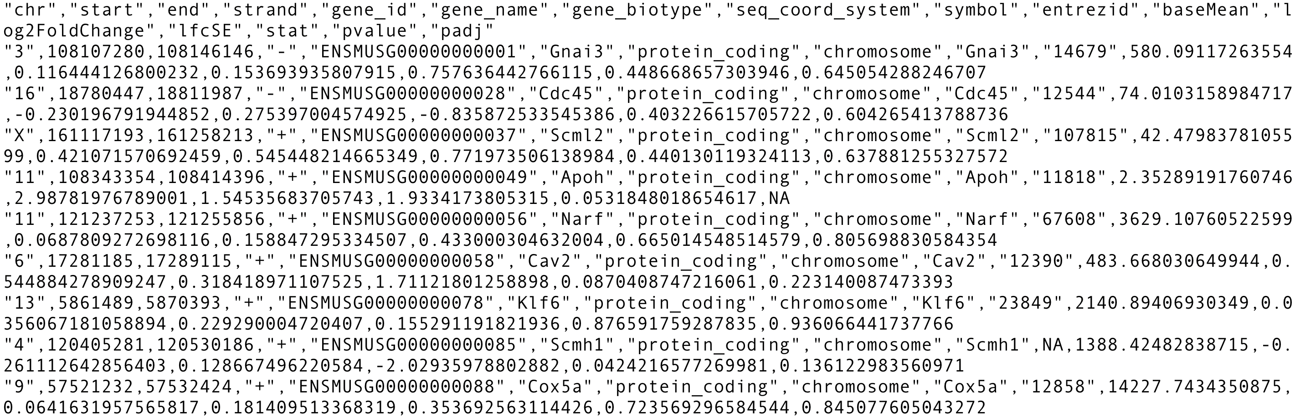
Why UNIX command line?
Researchers deal with large amounts of data in various text formats
How do we extract relevant information?
How do we carry out simple analysis?
How do we manipulate and manage large amounts of data?

Slide 4
UNIX command line
Most high-performance computing clusters use Unix/Linux operating system
Some software require command-line knowledge
It is widely-used, easy to find help online

Slide 5
Command-line
Command-line
Graphical User Interface
Ease | Higher degree of memorization and familiarity required | More visually intuitive
Control | More control over files | Advance tasks still may need to require command-line
Speed | Keyboard is utilized | Keyboard + mouse utilized
Scripting | Can create scripts for a sequence of commands | Much less flexible for writing programs
Diversity | Original commands remain the same | Interface can change with new versions
https://www.computerhope.com/issues/ch000619.htm

Slide 6
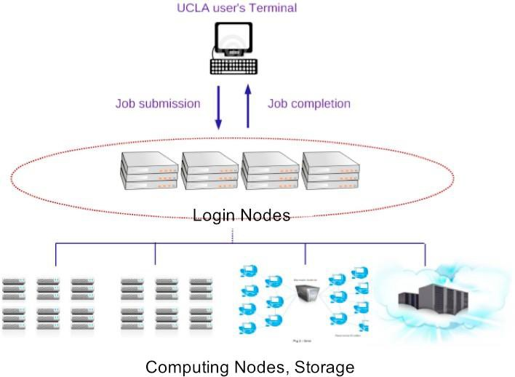
Hoffman2 cluster

Slide 7
Connecting to Hoffman2 cluster
Open a SSH program on your computer
Connect to hoffman2.idre.ucla.edu
Type your username and password
-> ssh asliyild@hoffman2.idre.ucla.edu
-> asliyild@hoffman2.idre.ucla.edu's password:
Notice that when you type a password, nothing shows up on the screen, this is for your security

Slide 8






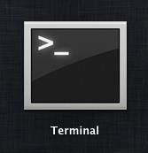
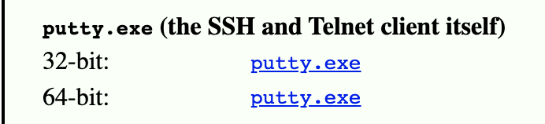
Connecting to Hoffman2 cluster
Terminal
putty, Cygwin, Ubuntu for Windows (new app Windows 10)
https://www.chiark.greenend.org.uk/~sgtatham/putty/latest.html

Slide 9

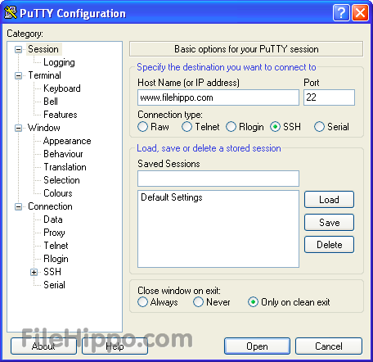
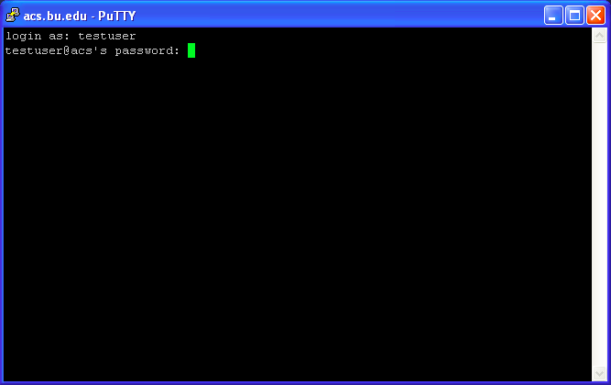


Putty for Windows
hoﬀman2.idre.ucla.edu
“Yes” for ﬁngerprint for the ﬁrst time!
Session name (e.g. hoﬀman2)

Slide 10
The UNIX shell
A Shell provides you with an interface to the Unix system.
It waits for you to type a command and then executes it.
When a program finishes executing, it displays that program's output.
Shell is an environment in which we can run our commands, programs, and shell scripts.

Slide 11
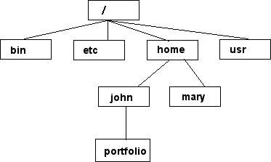

UNIX file system
/home/mary/
/home/john/portfolio/
path
Home directory

Slide 12
Command: pwd
pwd: displays current directory path
When you login to the hoffman2 server, you start in your home directory.
[asliyild@login4 ~]$ pwd
/u/home/a/asliyild

Slide 13
Command: mkdir
mkdir: make directory
Syntax:
mkdir <directory path>
[asliyild@login4 ~]$ mkdir test

Slide 14
Command: cd
cd: change directory
Syntax:
cd <directory path>
Some options for directory path:
current directory: ./
parent directory: ../
previous directory: -
home directory: ~
[asliyild@login4 ~]$ cd
/u/home/a/asliyild

Slide 15
Command: ls
ls: list files/folders in the current directory
Syntax:
ls -<flag> <filename>
Some options for flags:
long listing format (more info): -l
sort by modification time: -t
reverse order: -r
human readable: -h
[asliyild@login4 ~]$ ls -ltrh

Slide 16
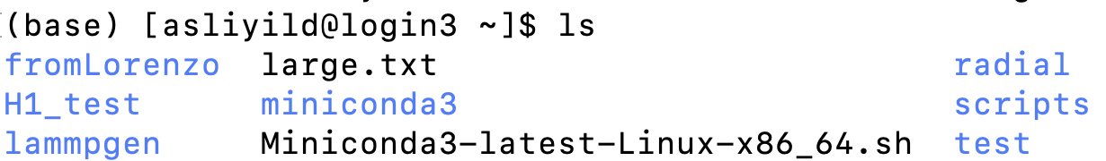
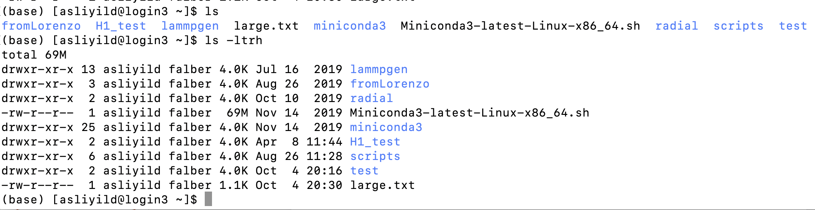
Command: ls (examples)
ls:
ls -ltrh:
File permissions

Slide 17
File permissions
Each file in UNIX has an associated permission level
This allows user to prevent others from reading/writing/executing their files or directories
Use "ls –l filename" to find the permission level of that file
There are 3 kinds of users: you, group and others.
File
type
You
Others
r: reading permission
w: writing permission
x: executing permission
Group

Slide 18
Command: vi
vi: creating/visualizing a file
Syntax:
vi <filename>
If the file exits, then you can visualize it with "vi".
If the file doesn't exist, then you can create a new file with "vi".
Other options: vim, nano, gedit, ...

Slide 19
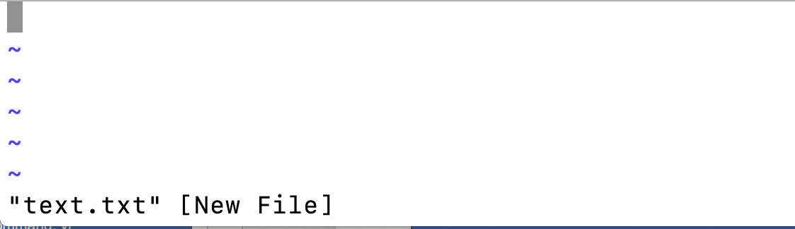
Command: vi (examples)
vi test.txt

Slide 20
Command: vi (examples)
Once inside the file:
Hit "i" to type in new text (insert)
Hit "ESC" to get out of the insert mode
Hit ":" to type commands within vi
:wq! (write and quit)
:q! (quit)
:w! (write)

Slide 21
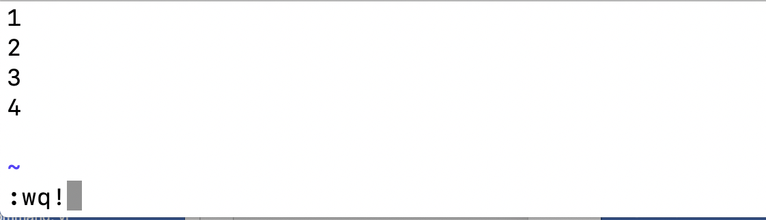
Command: vi (examples)
Type a number in each line (1 – 4) and save/quit the file:

Slide 22
Command: cat
cat: display a file (prints out the file in the shell)
Syntax:
cat <filename>
[asliyild@login4 ~]$ cat test.txt
1
2
3
4

Slide 23
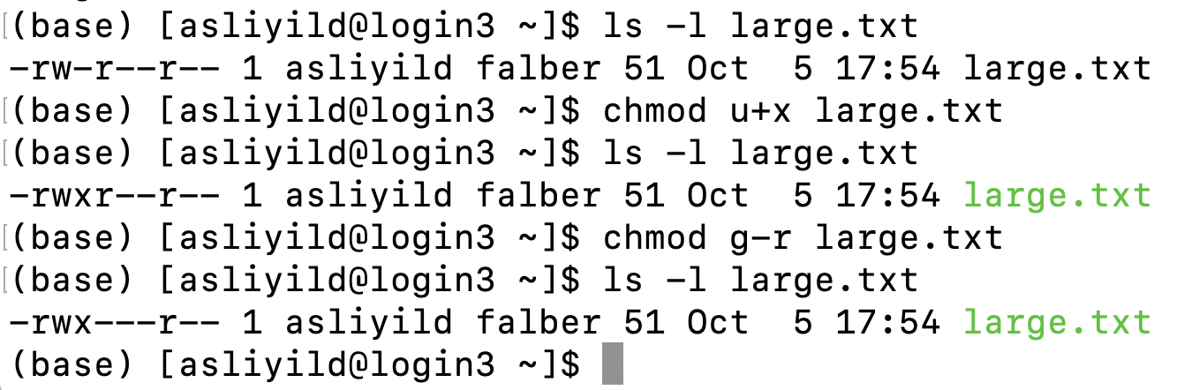
Command: chmod
chmod: change mode
Syntax:
chmod [user/group/others/all]+-[permission] [file(s)]

Slide 24
Useful tips
to go back to previously entered commands, use the up and down arrows
to auto complete file/folder names, use tab key
if you are stuck within a command use Ctrl+C

Slide 25
Useful tips
use " * " as a wildcard in commands (e.g. ls t* - list all files with filenames starting with t)
use backslash "\" before space to call file and folder names containing space

Slide 26
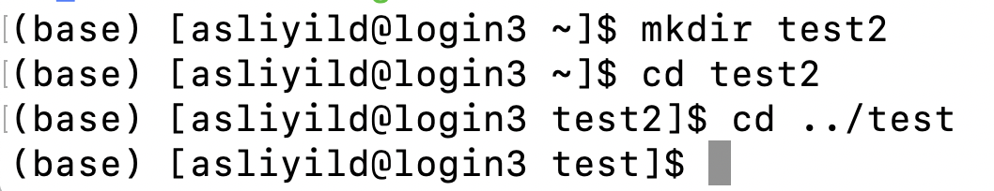
Useful tips
You can refer to a file/folder with a relative path or an absolute path
relative path
absolute path

Slide 27
Command: cp
cp: copy a file
Syntax:
cp <filename1> <filename2>
cp <filename> <path>
Options:
interactive: -i
recursive: -r
force: -f
verbose: -v

Slide 28
Command: cp (examples)
[asliyild@login4 ~]$ cp test.txt test2.txt
[asliyild@login4 ~]$ ls
test.txt test2.txt
[asliyild@login4 ~]$ cp -r test test2
[asliyild@login4 ~]$ ls
test test2

Slide 29
Command: mv
mv: move to a different location or rename a file
Syntax:
mv <filename1> <filename2>
mv <filename1> <path>
[asliyild@login4 ~]$ mv test.txt test2.txt
[asliyild@login4 ~]$ ls
test2.txt

Slide 30
Command: rm
rm: remove a file
rm –r: remove a folder
Syntax:
rm <filename>
rm –r <foldername>
[asliyild@login4 ~]$ rm test2.txt
[asliyild@login4 ~]$ ls

Slide 31
Command: rmdir
rmdir: remove an empty folder
Syntax:
rmdir <foldername>
[asliyild@login4 ~]$ rmdir test
[asliyild@login4 ~]$ ls

Slide 32
Useful tips
cp/mv/rm commands can work on multiple file at once:
cp file1 file2 new/
rm file1 file2 file27
cp/mv/rm can work with "*":
mv f* new/
rm f*
rm l*s
rm *txt

Slide 33
Warning: rm
There is generally no coming back from rm, the file does not go to a trash folder that you can recover it from – so always backup your data.
Backup your files on external drive
Modify your personal Linux environment
Hoffman2 recover option: https://support.idre.ucla.edu/helpdesk/KB/View/6079312-i-deleted-a- file-in-my-home-directory--how-can-i-recover-it

Slide 34
Command: tar
tar: creates a compressed archive
Syntax:
tar –czvf <filename1>.tar.gz <filename1>
tar –xzvf <filename1>.tar.gz
Options:
create: -c
verbose: -v
file type: -f
extract: -x
zip: -z

Slide 35
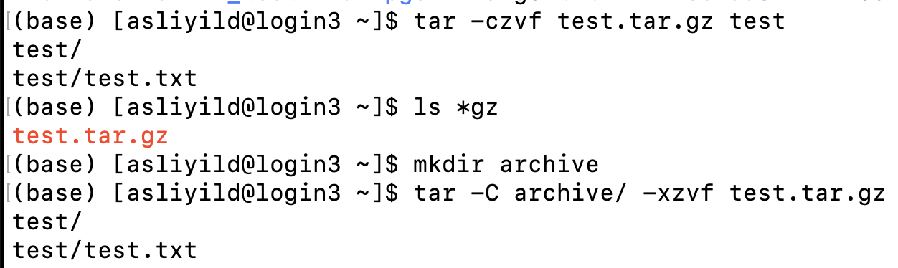
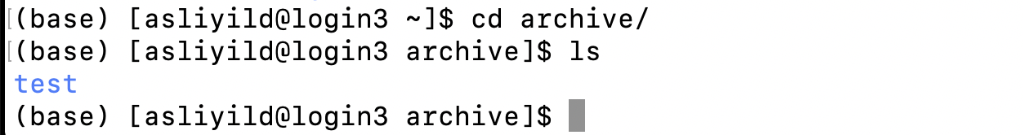
Command: tar (examples)
Create a tar file:
Extract a tar file:
path to the directory

Slide 36








Command: scp (remote cp)
File located on the laptop, in the current directory
localFile
scp <localFile>
user@hoffman2.idre.ucla.edu:<path>
Where on the cluster
<localFile> will be copied
remoteFile
scp user@hoffman2.idre.ucla.edu:<path>/<remoteFile> ./
File located on the cluster, in the <path> directory
Run scp from the local session of the terminal.

Slide 37
Command: sftp (file transfer)
From Hoffman2 to local computer (get):
[asliyild@login4 ~]$ sftp asliyild@hoffman2.idre.ucla.edu
[asliyild@login4 ~]$ get test.txt
[asliyild@login4 ~]$ bye
From local computer to Hoffman2 (put):
[asliyild@login4 ~]$ sftp asliyild@hoffman2.idre.ucla.edu
[asliyild@login4 ~]$ put test.txt
[asliyild@login4 ~]$ bye
Run sftp from the local session of the terminal.
For windows: pscp.exe or psftp.exe can be used (from putty: https://www.chiark.greenend.org.uk/~sgtatham/putty/latest.html)

Slide 38



Other options: file transfer
WinSCP
(for Windows)
FileZilla
(for Windows, MacOS, Linux)
CyberDuck
(for Windows, MacOS)
https://winscp.net/eng/index.php
https://filezilla-project.org/
https://cyberduck.io/

Slide 39
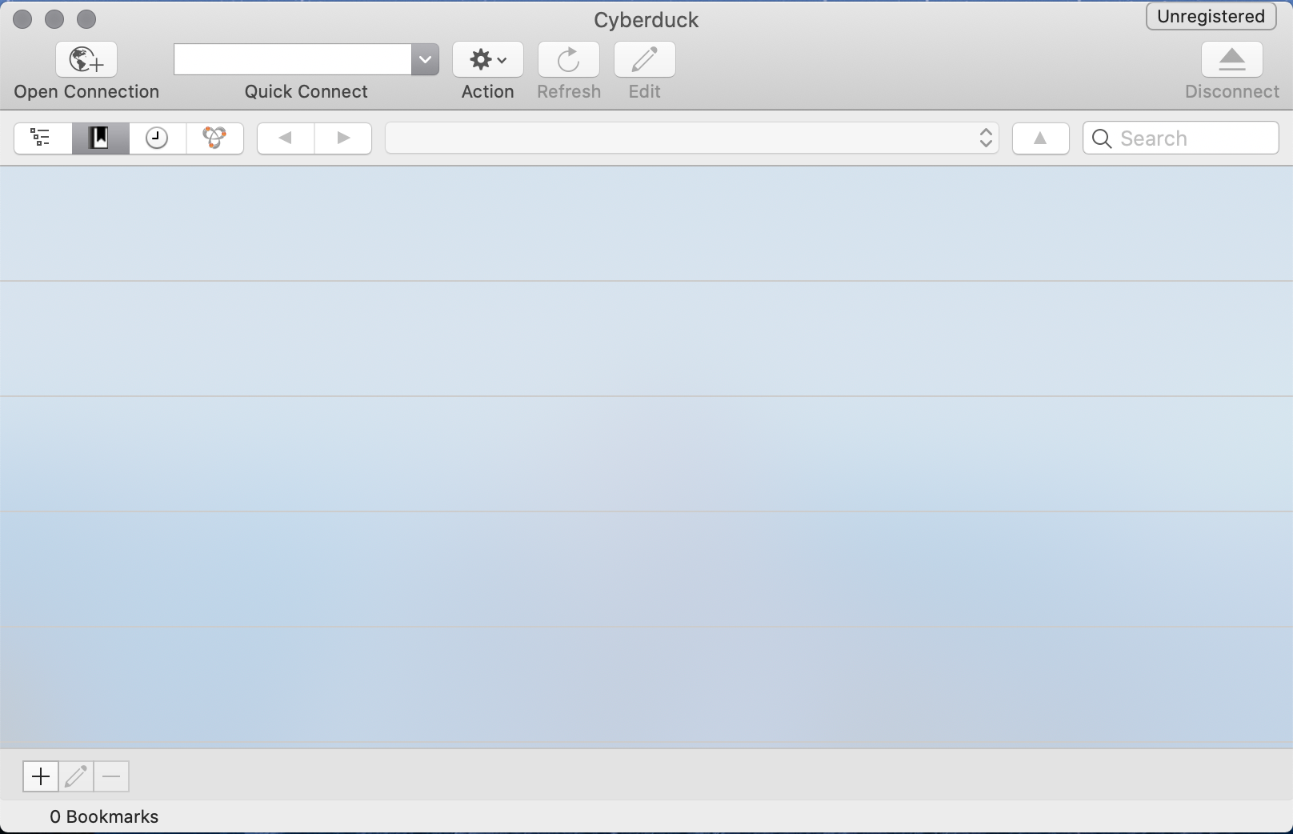
Cyberduck
open connection
https://cyberduck.io/

Slide 40
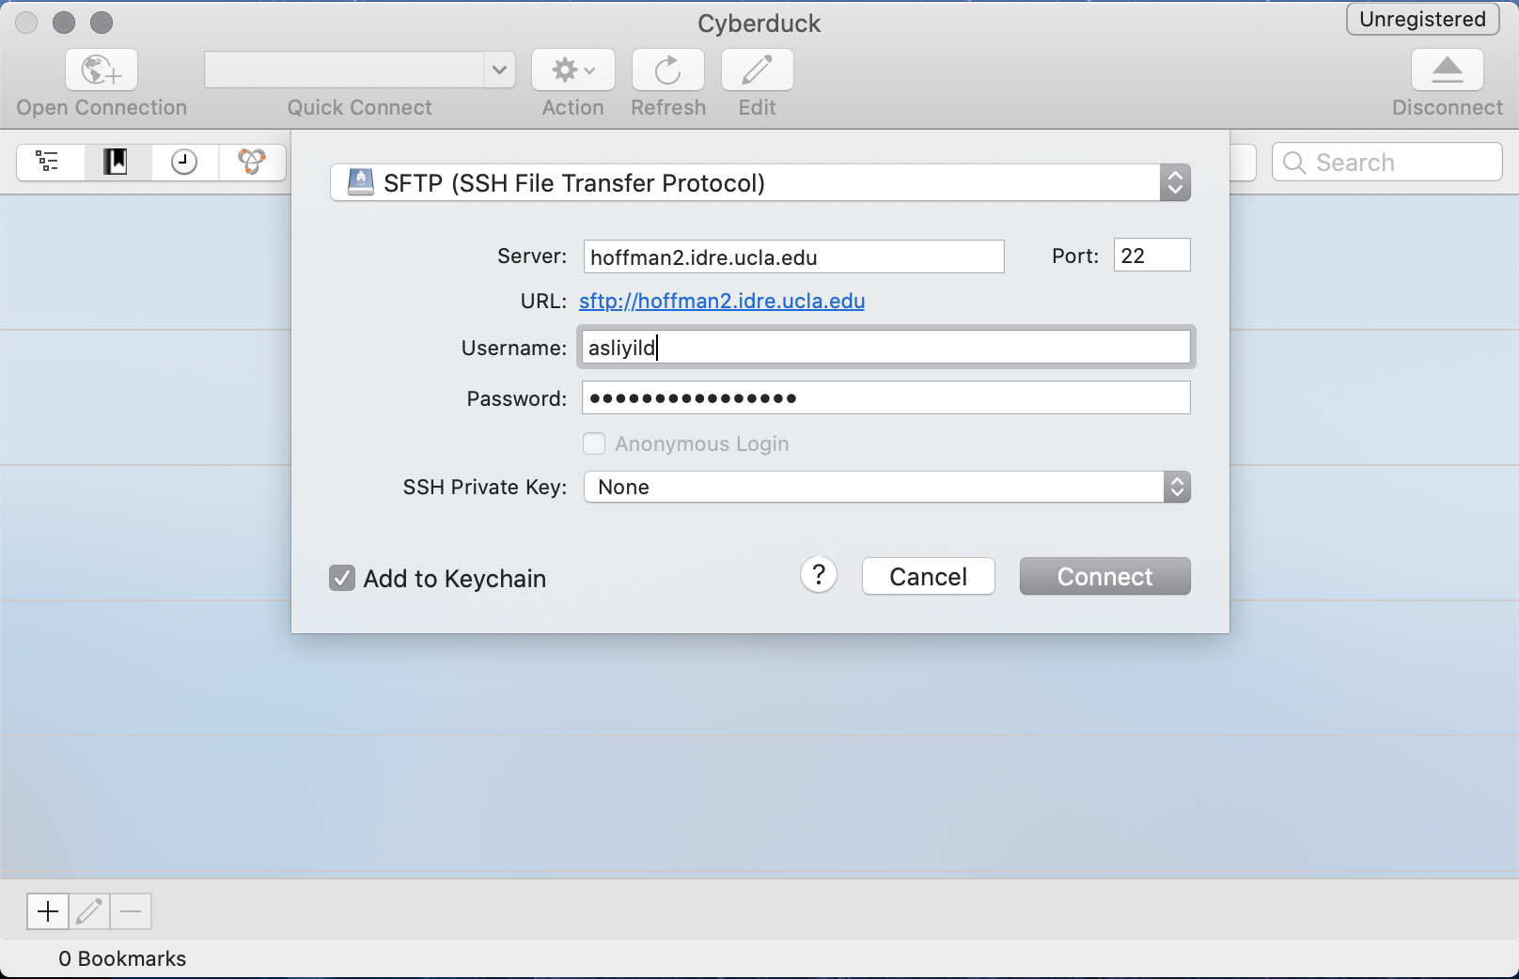
Cyberduck
enter info
https://cyberduck.io/

Slide 41
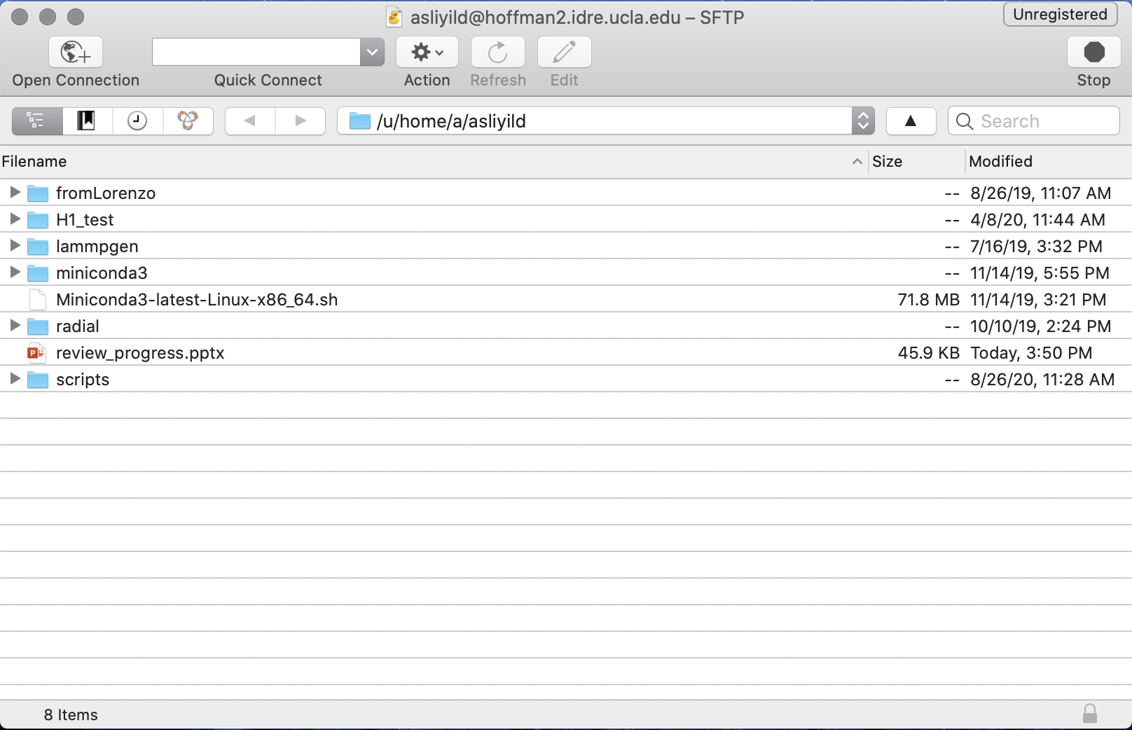
Cyberduck
Hoffman2 home
https://cyberduck.io/

Slide 42
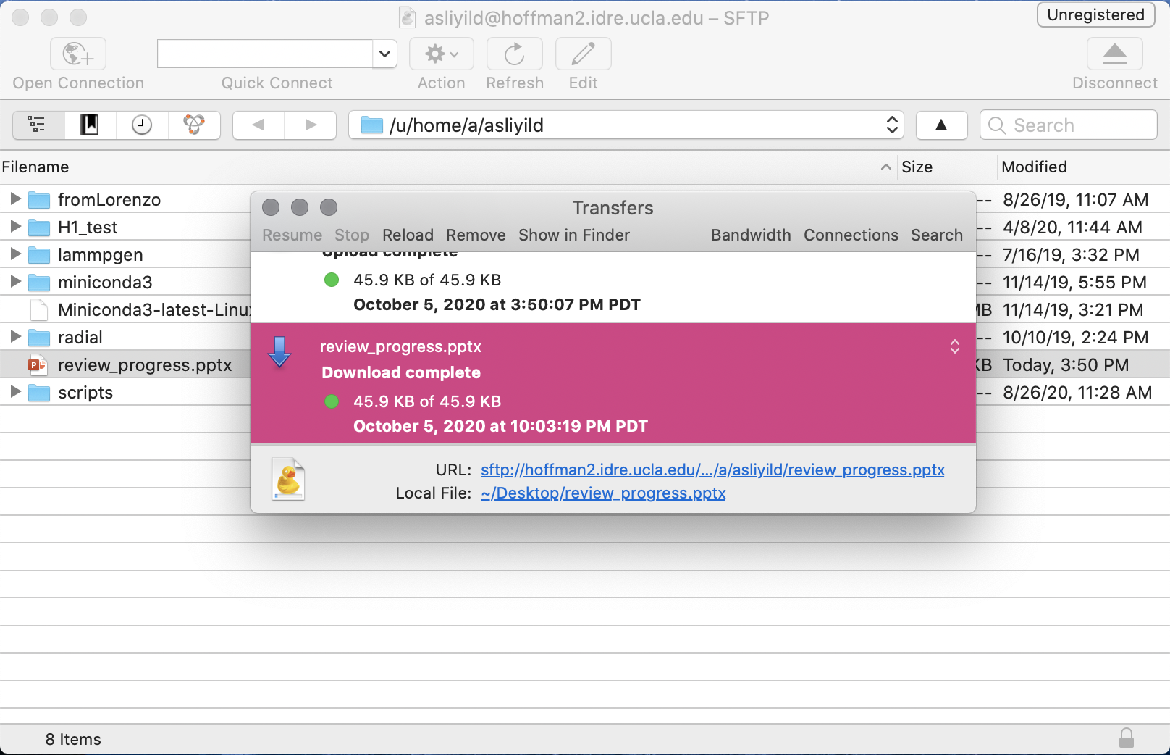
Cyberduck
Drag and drop
https://cyberduck.io/

Slide 43
Command: alias
alias: creates a shortcut
Syntax:
alias customname="command"
[asliyild@login4 ~]$ alias cp="cp –i"
[asliyild@login4 ~]$ alias rm="rm –i"
[asliyild@login4 ~]$ alias mv="mv -i"
To keep this shortcut beyond the current session (put it in the bash_profile):
[asliyild@login4 ~]$ vi ~/.bash_profile
[asliyild@login4 ~]$ source ~/.bash_profile

Slide 44
Command: alias (examples)
In your local computer:
alias hoffman2="ssh asliyild@hoffman2.idre.ucla.edu"
source ~/.bash_profile
hoffman2

Slide 45
More useful commands
passwd: to change your password
man <command>: command manual
history: history of your previous commands

Slide 46
Common errors:
command not found: possible typo in the command
file exists: files/folders should have unique names under the same directory

Slide 47
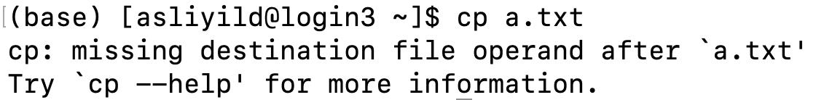
Common errors:
missing destination file: cp/mv needs destination path/file name
no such file or directory: file does not exist in the current directory

Slide 48
Commands - Day 1 (summary)
pwd | displaying current path
ls | list files
chmod | change mode (file permissions)
mkdir | make directory
cd | change directory
vi | visualize/create files
cp | copy a file
mv | move/rename a file
rm | remove a file
alias | shortcut
man | manual for commands
history | history of previous commands
passwd | change password
tar | create a compressed archive
scp/sftp | file transfer
More options/info on commands: Google!

Slide 49
Practice:
create a directory "practice" in your home directory
create 3 new files under practice: a.txt, b.txt, c.txt
Add line "my first text file!" to a.txt
Add line "my second text file!" to b.txt
Add line "my third text file!" to c.txt
create copies of these 3 files: a2.txt, b2.txt, c2.txt
create another directory "practice2" in your home directory
move a2.txt, b2.txt, c2.txt to practice2 directory
remove "practice" directory
add writing permission for the group for a2.txt
add executing permission for the user for b2.txt
remove reading permission for others for c2.txt
(Which files did change color when listed?)
cp practice2 directory to your local computer using cyberduck

